Slide 1
Chapter 23
Money and the financial system

Slide 2
1 金融市场概览 （了解）
2 货币的三个功能：交易媒介、价值储藏和计价单位
3 M0/M1/M2
4 货币需求
5 货币供给：商业银行如何创造货币
6 股票市场的有效市场假说和泡沫（了解）
7 货币数量论 （p489)(考试！）

Slide 3

中国人民银行决定，自2014年11月22日起下调金融机构人民币贷款和存款基准利率：
金融机构一年期贷款基准利率下调0.4个百分点至5.6%；一年期存款基准利率下调0.25个百分点至2.75%，同时结合推进利率市场化改革，将金融机构存款利率浮动区间的上限由存款基准利率的1.1倍调整为1.2倍；其他各档次贷款和存款基准利率相应调整，并对基准利率期限档次作适当简并。

Slide 4
A. The modern financial system
Overview of the monetary transmission Mechanism
  the central bank announces a target short-term interest rate
  Daily open-market operations
  Determine the entire spectrum of short and long term interest rate
  The changes in interest rates affect investment and consumption and net export
  Affect the path of output and inflation

Slide 5
The modern financial system
The role of financial system
  Financial system
  Financial market and financial intermediaries

Slide 6
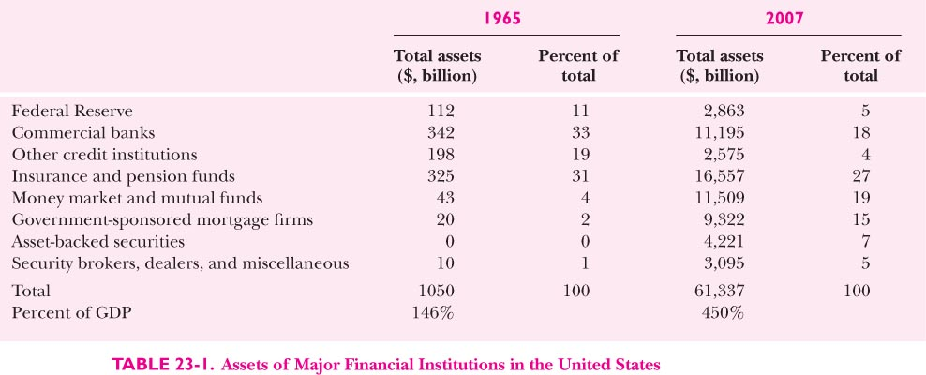

Slide 7
社会融资规模统计表
Aggregate Financing to the Real Economy （AFRE)
单位：亿元人民币
Unit: 100 million Yuan
 |  |  | 其中 Of which
 | 社会融资规模 | 人民币贷款 | 外币贷款（折合人民币） | 委托贷款 | 信托贷款 | 未贴现银行承兑汇票 | 企业债券 | 非金融企业境内股票融资
AFRE | RMB loans | Foreign currency-denominated loans (RMB equivalent) | Entrusted loans | Trust loans | Undiscounted bankers' acceptances | Net financing of corporate bonds | Equity financing on the domestic stock market by non-financial enterprises
2013.01 | 25446 | 10721 | 1795 | 2061 | 2108 | 5798 | 2249 | 244
2013.02 | 10705 | 6200 | 1149 | 1426 | 1825 | -1823 | 1454 | 165
2013.03 | 25503 | 10625 | 1509 | 1748 | 4312 | 2731 | 3870 | 208
2013.04 | 17629 | 7923 | 847 | 1926 | 1942 | 2218 | 2039 | 274
2013.05 | 11871 | 6694 | 357 | 1967 | 971 | -1141 | 2230 | 231
2013.06 | 10375 | 8628 | 133 | 1990 | 1208 | -2615 | 323 | 126
2013.07 | 8191 | 6997 | -1157 | 1927 | 1151 | -1777 | 476 | 128
2013.08 | 15841 | 7128 | -360 | 2938 | 1209 | 3049 | 1240 | 136
2013.09 | 14120 | 7870 | 891 | 2218 | 1130 | -79 | 1443 | 113
2013.10 | 8645 | 5060 | 53 | 1834 | 431 | -345 | 1078 | 78
2013.11 | 12310 | 6246 | 122 | 2704 | 1006 | 60 | 1424 | 147
2013.12 | 12532 | 4824 | 509 | 2727 | 1111 | 1679 | 287 | 369
注： 1.社会融资规模是指一定时期内实体经济从金融体系获得的资金总额，是增量概念。
AFRE refers to the total volume of financing provided by the financial system to the real economy during a certain period of time. It is a flow.
2.数据来源于中国人民银行、国家发展和改革委员会、中国证券监督管理委员会、中国保险监督管理委员会、中央国债登记结算有限责任公司和中国银行间市场交易商协会等。
In the calculation of AFRE, data were from the PBC, NDRC, CSRC, CIRC, CCDC and NAFMII.

Slide 8
全国股票交易统计表
 | 时期 |  | 总股本(亿股) |  | 市价总值(亿元) |  | 成交金额(亿元) |  | 成交量(百万股) |  |  |  | 最高综合股价指数 |  |  |  | 最低综合股价指数
 | Volume Issued |  | Total Market Capitalization |  | Turnover of Trading |  | Trading Volume |  |  |  |  |  |  |  |  |  | High Composite Index
 | (100 Million Shares) | (100 Million Yuan) | (100 Million Yuan) | (One Million Shares)
 |  |  |  |  |  |  |  |  | 上海 | 深圳 | 上海 | 深圳 | 上海 | 深圳 | 上海 | 深圳 | 上海Shanghai
 | A股 | B股 | A股 | B股 | A股 | B股 | A股 | B股
Shanghai | Shenzhen | Shanghai | Shenzhen | Shanghai | Shenzhen | Shanghai | Shenzhen | A Share | B Share | A Share | B Share | A Share | B Share | A Share | B Share
2012年累计 |  |  |  |  | 164461 | 150122 | 1892843 | 1393212
2013.01 | 24692 | 7251 | 167497 | 76411 | 22660 | 20542 | 268184 | 197196 | 2504 | 280 | 984 | 880 | 2340 | 246 | 906 | 719
2013.02 | 24717 | 7263 | 166306 | 79210 | 16319 | 13954 | 183102 | 126486 | 2559 | 288 | 1017 | 873 | 2397 | 265 | 969 | 807
2013.03 | 24734 | 7321 | 157312 | 76373 | 20452 | 18244 | 233441 | 168379 | 2480 | 279 | 1022 | 850 | 2333 | 259 | 950 | 771
2013.04 | 24787 | 7427 | 153372 | 75269 | 12887 | 12853 | 150143 | 116816 | 2358 | 267 | 990 | 830 | 2267 | 250 | 929 | 755
2013.05 | 24896 | 7692 | 162318 | 85437 | 20970 | 24048 | 230523 | 212657 | 2443 | 271 | 1093 | 884 | 2262 | 251 | 944 | 804
2013.06 | 25251 | 7855 | 139775 | 73038 | 13326 | 15167 | 155527 | 140672 | 2422 | 268 | 1084 | 881 | 1936 | 223 | 851 | 708
2013.07 | 25395 | 7946 | 141092 | 77440 | 18236 | 23266 | 216981 | 211099 | 2191 | 246 | 1028 | 789 | 2037 | 230 | 920 | 743
2013.08 | 25460 | 7954 | 148445 | 81747 | 20726 | 24435 | 249496 | 224354 | 2302 | 251 | 1075 | 826 | 2090 | 236 | 986 | 771
2013.09 | 25499 | 7990 | 154176 | 87100 | 25466 | 21418 | 300768 | 199206 | 2377 | 258 | 1109 | 842 | 2176 | 240 | 1035 | 804
2013.10 | 25562 | 8006 | 151970 | 84225 | 21017 | 22439 | 238268 | 199732 | 2348 | 260 | 1155 | 866 | 2191 | 243 | 1037 | 818
2013.11 | 25600 | 8022 | 157701 | 89983 | 19287 | 20807 | 219559 | 185408 | 2339 | 256 | 1138 | 881 | 2176 | 238 | 1031 | 813
2013.12 | 25752 | 8070 | 151165 | 87912 | 18262 | 21291 | 210382 | 183376 | 2367 | 261 | 1121 | 899 | 2165 | 246 | 1054 | 846
2013年累计 |  |  |  |  | 229609 | 238463 | 2656373 | 2165382

Slide 9
交易所政府债券交易统计表
 | 时期 |  | 总计 Total |  | 上交所 Shanghai Stock Exchange |  | 深交所 Shenzhen Stock Exchange
 | 国债交易合计 |  | 现货 |  | 回购 |  | 现货 |  | 回购 |  | 现货 |  | 回购
 | T-Bond Transaction in Total | Spot Trading | Repo.Trading | Spot Trading | Repo.Trading | Spot Trading | Repo.Trading
 | 成交金额 | 成交量 | 成交金额 | 成交量 | 成交金额 | 成交量 | 成交金额 | 成交量 | 成交金额 | 成交量 | 成交金额 | 成交量 | 成交金额 | 成交量
 | (亿元) | (万手) | (亿元) | (万手) | (亿元) | (万手) | (亿元) | (万手) | (亿元) | (万手) | (亿元) | (万手) | (亿元) | (万手)
 | Turnover of Tranding | Trading Volume | Turnover of Tranding | Trading Volume | Turnover of Tranding | Trading Volume | Turnover of Tranding | Trading Volume | Turnover of Tranding | Trading Volume | Turnover of Tranding | Trading Volume | Turnover of Tranding | Trading Volume
(100 Million Yuan) | (10 Thousand Lots) | (100 Million Yuan) | (10 Thousand Lots) | (100 Million Yuan) | (10 Thousand Lots) | (100 Million Yuan) | (10 Thousand Lots) | (100 Million Yuan) | (10 Thousand Lots) | (100 Million Yuan) | (10 Thousand Lots) | (100 Million Yuan) | (10 Thousand Lots)
2012年累计 | 347242 | 3473099 | 881 | 9492 | 346361 | 3463607 | 873 | 8623 | 346361 | 3463607 | 9 | 869 | 0 | 0
2013.01 | 35286 | 352969 | 73 | 839 | 35213 | 352130 | 72 | 711 | 37882 | 378821 | 1 | 128 | 0 | 0
2013.02 | 26599 | 266059 | 62 | 691 | 26537 | 265368 | 61 | 606 | 28492 | 284917 | 1 | 85 | 0 | 0
2013.03 | 39513 | 395307 | 70 | 880 | 39443 | 394428 | 68 | 677 | 42336 | 423358 | 2 | 203 | 0 | 0
2013.04 | 34795 | 348060 | 77 | 880 | 34718 | 347180 | 76 | 749 | 37329 | 373291 | 1 | 131 | 0 | 0
2013.05 | 48748 | 487481 | 58 | 575 | 48691 | 486906 | 58 | 569 | 51846 | 518462 | 0 | 6 | 0 | 0

Slide 10
 | 1天 |  | 7天 |  | 14天 |  | 21天 |  | 30天 |  | 60天 |  | 90天 |  | 120天 |  | 6个月 |  | 9个月 |  | 1年
 | Overnight |  | 7 Days |  | 14 Days |  | 21 Days |  | 30 Days |  | 60 Days |  | 90 Days |  | 120 Days |  | 6Months |  | 9Months |  | 1Years
 | 交易量 | 加权平均利率(%) | 交易量 | 加权平均利率(%) | 交易量 | 加权平均利率(%) | 交易量 | 加权平均利率(%) | 交易量 | 加权平均利率(%) | 交易量 | 加权平均利率(%) | 交易量 | 加权平均利率(%) | 交易量 | 加权平均利率(%) | 交易量 | 加权平均利率(%) | 交易量 | 加权平均利率(%) | 交易量 | 加权平均利率(%)
 | Trading Volume | Weighted Average Interest Rate(%) | Trading Volume | Weighted Average Interest Rate(%) | Trading Volume | Weighted Average Interest Rate(%) | Trading Volume | Weighted Average Interest Rate(%) | Trading Volume | Weighted Average Interest Rate(%) | Trading Volume | Weighted Average Interest Rate(%) | Trading Volume | Weighted Average Interest Rate(%) | Trading Volume | Weighted Average Interest Rate(%) | Trading Volume | Weighted Average Interest Rate(%) | Trading Volume | Weighted Average Interest Rate(%) | Trading Volume | Weighted Average Interest Rate(%)
2012年累计 | 402814 |  | 41934 |  | 12068 |  | 2370 |  | 4476 |  | 1626 |  | 1170 |  | 81 |  | 379 |  | 29 |  | 97
2013.01 | 33896 | 2.13 | 3047 | 3.27 | 719 | 3.14 | 91 | 3.68 | 234 | 3.89 | 69 | 4.17 | 222 | 4.11 | 17 | 3.86 | 41 | 4.16 | 0 | - | 9 | 4.48
2013.02 | 23010 | 2.59 | 3102 | 3.44 | 1140 | 3.67 | 195 | 4 | 337 | 4.16 | 70 | 3.75 | 34 | 4.03 | 11 | 4.48 | 1 | 4.4 | 0 | - | 6 | 4.42
2013.03 | 30720 | 2.31 | 4302 | 3.22 | 564 | 3.47 | 98 | 3.32 | 767 | 3.41 | 38 | 3.87 | 112 | 4.24 | 1 | 3.88 | 2 | 4.3 | 0 | - | 3 | 4.33
2013.04 | 37911 | 2.38 | 3160 | 3.37 | 738 | 3.5 | 345 | 3.32 | 588 | 3.66 | 53 | 3.52 | 116 | 3.88 | 2 | 4.2 | 5 | 4.01 | 0 | - | 1 | 4
2013.05 | 38622 | 2.8 | 3953 | 3.71 | 864 | 3.69 | 67 | 3.34 | 748 | 3.88 | 69 | 3.57 | 53 | 4.26 | 2 | 4.03 | 0 | - | 0 | - | 1 | 4.33
2013.06 | 11324 | 6.43 | 3125 | 6.98 | 805 | 7.07 | 32 | 7.13 | 161 | 6.79 | 57 | 6.44 | 86 | 5.92 | 3 | 5 | 23 | 5.91 | 0 | - | 11 | 3.97
2013.07 | 18775 | 3.34 | 3759 | 4.1 | 807 | 4.24 | 101 | 4.58 | 352 | 5.23 | 52 | 5.07 | 152 | 5.08 | 3 | 4.43 | 6 | 5.01 | 0 | 4.8 | 8 | 5.23
2013.08 | 19592 | 3.23 | 3911 | 4.1 | 675 | 4.52 | 97 | 4.83 | 255 | 4.67 | 55 | 5.27 | 84 | 5.24 | 2 | 5.8 | 14 | 4.98 | 0 | - | 15 | 5.49
2013.09 | 22371 | 3.22 | 3892 | 3.87 | 1911 | 4.64 | 473 | 4.57 | 447 | 5.18 | 83 | 5.41 | 125 | 5.46 | 6 | 4.57 | - | - | 2 | 5.09 | 18 | 5.51
2013.1 | 16880 | 3.62 | 3311 | 4.39 | 1158 | 4.24 | 92 | 5.04 | 440 | 5.26 | 116 | 5.05 | 225 | 5.32 | 4 | 4.3 | 7 | 5.78 | - | - | 10 | 5.72
2013.11 | 20190 | 3.88 | 4623 | 4.53 | 1057 | 5.08 | 34 | 6.01 | 390 | 5.75 | 159 | 5.68 | 335 | 6.45 | 2 | 4.63 | 8 | 5.25 | - | - | - | -
2013.12 | 16345 | 3.71 | 3839 | 5.17 | 1143 | 5.63 | 204 | 5.51 | 352 | 5.82 | 212 | 6.18 | 205 | 6.1 | 15 | 5.35 | 12 | 7 | - | - | 2 | 6.47
2013年累计 | 289636 |  | 44024 |  | 11579 |  | 1828 |  | 5070 |  | 1034 |  | 1748 |  | 67 |  | 119 |  | 2 |  | 83

Slide 11
债券回购
时期 | 1天 |  | 7天 |  | 14天 |  | 21天 |  | 1个月 |  | 2个月 |  | 3个月 |  | 4个月 |  | 6个月 |  | 9个月 |  | 1年
 | Overnight |  | 7Days |  | 14Days |  | 21Days |  | 1Month |  | 2Months |  | 3Months |  | 4Months |  | 6Months |  | 9Months |  | 1Year |  | 成交金额合计 | 加权平均利率
 | 成交金额 | 加权平均利率 | 成交金额 | 加权平均利率 | 成交金额 | 加权平均利率 | 成交金额 | 加权平均利率 | 成交金额 | 加权平均利率 | 成交金额 | 加权平均利率 | 成交金额 | 加权平均利率 | 成交金额 | 加权平均利率 | 成交金额 | 加权平均利率 | 成交金额 | 加权平均利率 | 成交金额 | 加权平均利率 | Total Turnover of Trading | Weighted Average Interest Rate
 | Turnover of Trading | Weighted Average Interest Rate | Turnover of Trading | Weighted Average Interest Rate | Turnover of Trading | Weighted Average Interest Rate | Turnover of Trading | Weighted Average Interest Rate | Turnover of Trading | Weighted Average Interest Rate | Turnover of Trading | Weighted Average Interest Rate | Turnover of Trading | Weighted Average Interest Rate | Turnover of Trading | Weighted Average Interest Rate | Turnover of Trading | Weighted Average Interest Rate | Turnover of Trading | Weighted Average Interest Rate | Turnover of Trading | Weighted Average Interest Rate
2012年累计 | 1109323 |  | 172165 |  | 47390 |  | 9913 |  | 13155 |  | 8120 |  | 4421 |  | 612 |  | 804 |  | 89 |  | 182 |  | 1366174
2013.01 | 115470 | 2.09 | 12420 | 3.09 | 3340 | 3.04 | 627 | 3.87 | 1017 | 3.94 | 466 | 3.99 | 1077 | 3.77 | 28 | 3.84 | 66 | 3.81 | 4 | 3.77 | 0 | - | 134516 | 2.25
2013.02 | 78500 | 2.68 | 9366 | 3.46 | 6944 | 3.87 | 1763 | 3.78 | 490 | 4.02 | 696 | 4.16 | 527 | 3.71 | 148 | 4.01 | 84 | 3.83 | 0 | - | 9 | 4 | 98527 | 2.89

Slide 12
The functions of financial system
Transfer resources across time
Manage risk for the economy
Pools and subdivides funds
Clearing house function

Slide 13
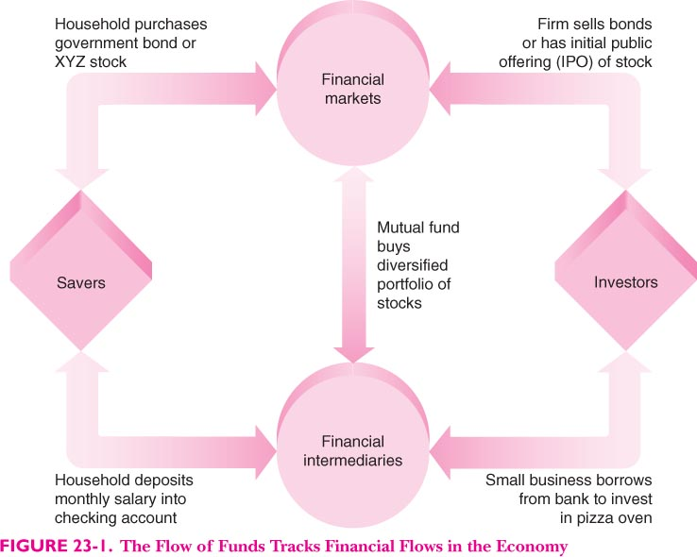
The flow of funds

Slide 14
A menu of financial assets
money
Saving accounts
Credit market instruments
Common stocks
Money market funds
Mutual funds
Pension funds
Financial derivatives

Slide 15
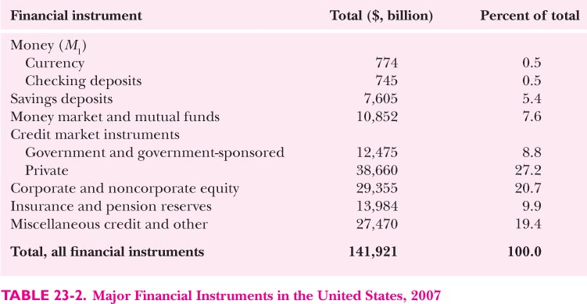

Slide 16
Review of interest rate
Interest arte is price paid for borrowing money

Slide 17
The special case of money
The evolution of money
  Barter
  Commodity money
  Modern money

Slide 18
The component of the money supply
Currency
Checking deposit
Demand deposit

Slide 19
B. The special case of money
The evolution of money
The history of money
  Barter
  Commodity money
  Modern money
Components of the money supply

Slide 20
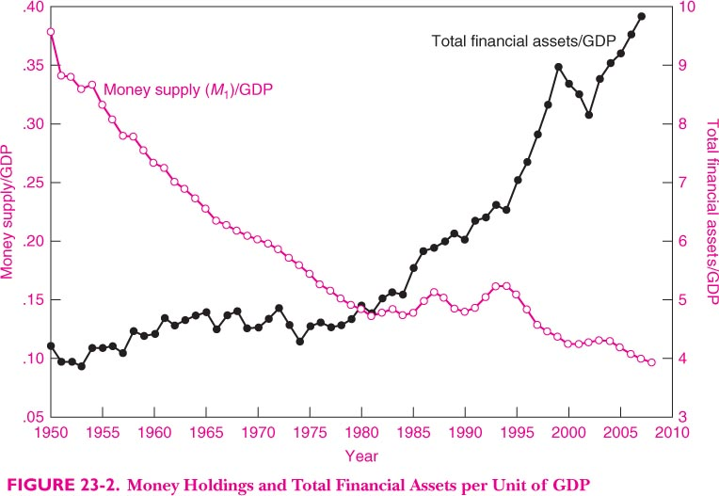

Slide 21
什么是货币我们为什么需要它？
M1: 最窄的定义
  M1 : 流通中的现金，支票账户，活期存款账户，旅行支票
  包括:
  1. 流通中的纸币和硬币，不是银行持有的和国库持有的
  2. 支票账户.
  3. 旅行支票
  4.活期存款

Slide 22
中国的划分
M0：流通中现金（货币供给量统计的机构范围之外的现金发行）
M1：M0＋企业存款（企业存款扣除单位定期存款和自筹基建存款）＋机关团体部队存款＋农村存款＋信用卡类存款（个人持有）
M2：M1＋城乡居民储蓄存款＋企业存款中具有定期性质的存款（单位定期存款和自筹基建存款）＋外币存款＋信托类存款
M3：M2＋金融债券＋商业票据＋大额可转让定期存单等
M1，即狭义货币；M2，即广义货币；M2－M1即准货币。

Slide 23
The demand for money
Money’s function
  Medium of exchange
  Unit of account
  Store of value
Cost of holding money
Two sources of money demand
  Transactions demand
  Asset demand

Slide 24
Banks and the supply of money
How banks developed from goldsmith establishment
Fractional reserve banking

Slide 25
The demand for money
Money’s function
The costs of holding money
Two sources of money demand
  Transactions demand for money
  Asset demand

Slide 26
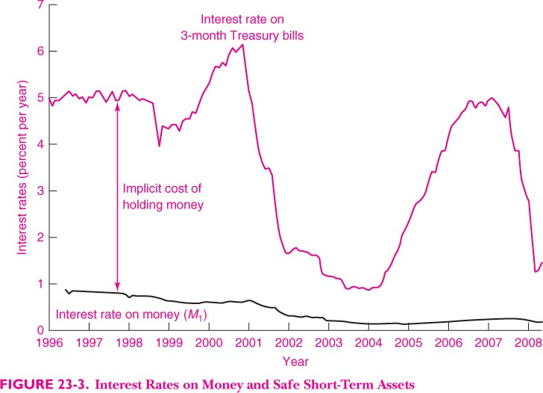

Slide 27
C. Banks and the supply of money
How banks developed from goldsmith establishments

Slide 28
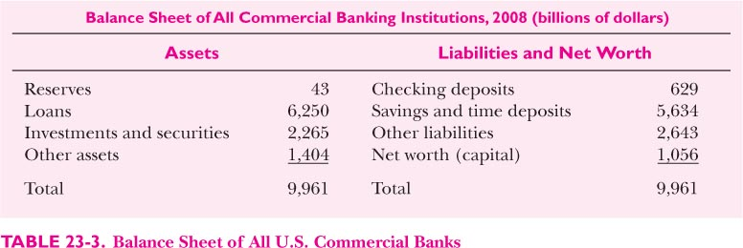

Slide 29
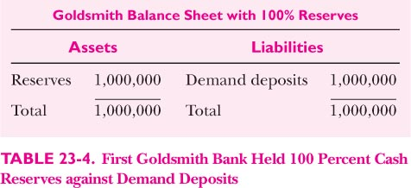

Slide 30
Fractional-reserve banking

Slide 31
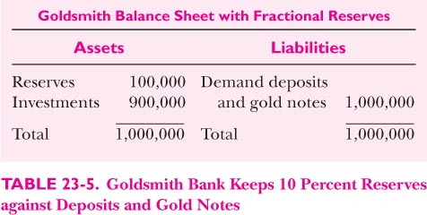

Slide 32
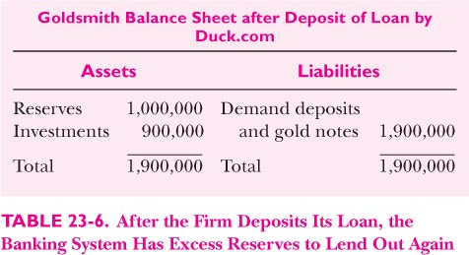

Slide 33
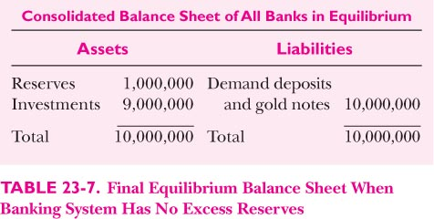

Slide 34
Total deposit=1,000,000*(1/(1-0.9))
Bank money=total *(1/(1-reserve ratio))

Slide 35
D. The stock market
Risk and return on different assets
  Income item
  Capital gain
  Risk refers to the variability of the returns.
  How to measure the risk? Standard deviation

Slide 36
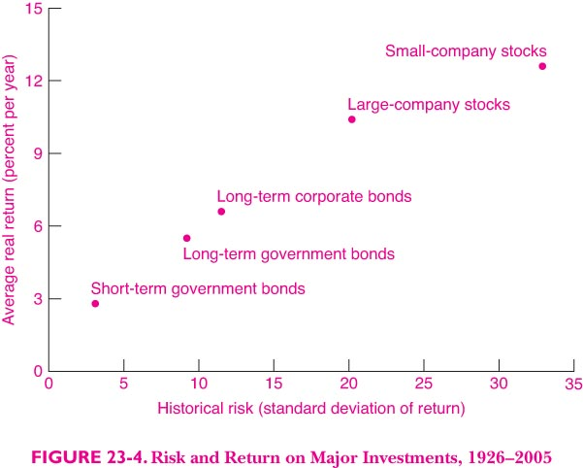

Slide 37
Bubbles and crashes
Efficient markets and the random walk
  Definition: extremely efficient in absorbing information about individual stocks and stocks market as whole
  Systems which attempt to forecast prices on the basis of the past or of fundamentals cannt produce returns greater than those that could be obtained by holding a randomly selected portfolio of individual stock of comparable risk
  Rationale for the efficient-market view
  A random walk
  Qualifications to the efficient-market view
    Anomalies
    Sharp movement: Oct 15,1987
    Individual stock rather whole market
  Personnel financial statement
    Know thy investment
    Diversify,diverfsify
    Index fund
    Minimize unnecessary cost

Slide 38
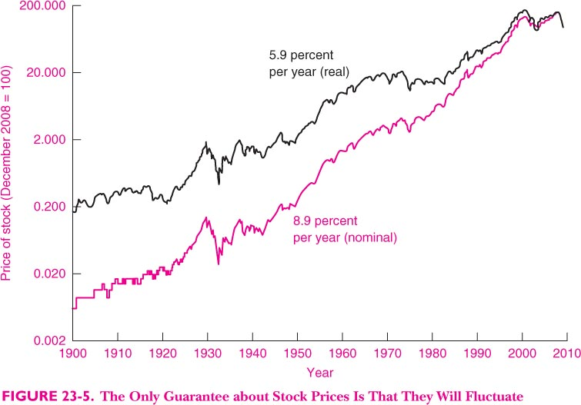

Slide 39
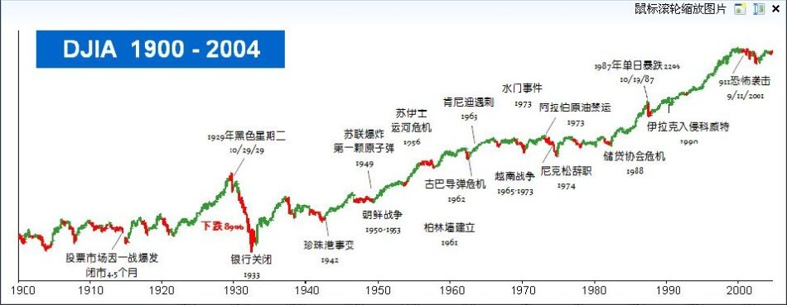

Slide 40
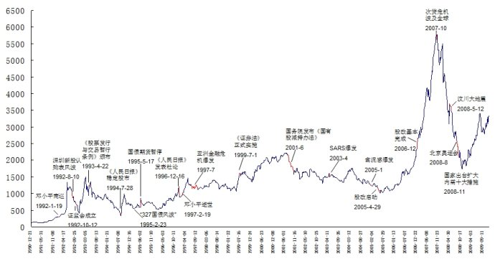

Slide 41
Personal financial strategies

